Slide 1
INTELLIGENT MANHOLE MONITORING SYSTEM USING IOT AND
BLYNK CLOUD
Team Members:
I.Sathiya priya-911719104060
A.Reema Hajra-911719104056
M.Selcia -911719104062

Slide 2
Abstract
Architecture design for proposed system
Agenda
ER diagram
Algorithms
Expected outcomes
References
Code

Slide 3

ABSTRACT:
Drainage is the framework or procedure by which water, sewage or different fluids are depleted from a spot and to keep up the best possible capacity of waste, its condition ought to be checked consistently.In any case, physically it is exceptionally hard to screen all regions that a human can't reach.This impacts the blockage of underground funnels and floods of water causing medical issue.

Slide 4
The proposed framework is uses IoT technology which is ease ,less upkeep, long life and online constant framework, which update the metropolitan official by Instant message when any sewer vent crosses the limits esteem.
It additionally abstains from spreading ofcontamination because of mosquitoes and gives perfect and sound condition just as controls thesickness, for example, jungle fever, dengue, looseness of the bowels,and so forth. Theframework diminishes the mishap brought about by an uncovered sewer vent.

Slide 5
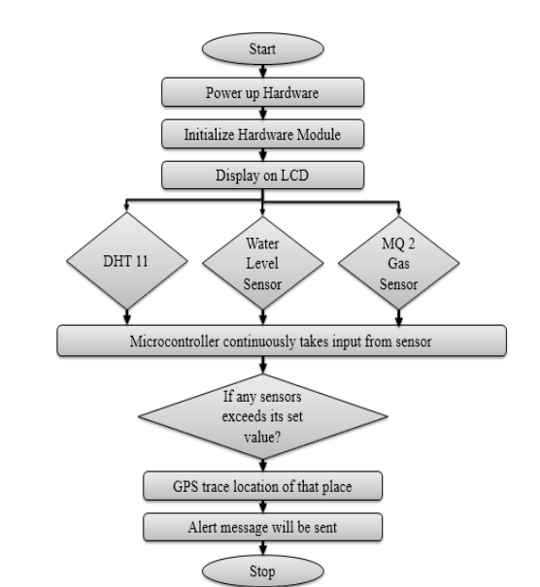
ARCHITECTURE DESIGN FOR PROPOSED SYSTEM

Slide 6

PROPOSED SYSTEM
The proposed system uses the IoT technology to provide an effective solution for monitoring manhole. The main reason to use IoT for continuous monitoring. The sensor node is deployed where a human cannot reach to monitor and collect the data. Our proposed system proposes the following features.

Slide 7
OUR PROPOSED SYSTEM PROPOSES THE FOLLOWING FEATURE
Detects the specific drain where the blockage occurs.
Detects toxic gas levels that would be harmful.
The system governs the flow of sewage from the pipes.
Finds out open vents to intimate, thus prevents accident.
Get the prior alerts of blockages and locate them using IOT

Slide 8
ER DIAGRAM
pressure reading
Notifying Authority
storing in database
Excessive rise in data
IOT based manhole Monitoring system
temperature readings
overflow detection
Excessive rise in data
notifying alarm
if alarming amount of gas detected
Lethal gases detection
Lid detection
sending location alert to authority
stolen lid
stolen lid
generate alarm
if motion detected in close proximity
motion detection near manhole

Slide 9
ALGORITHM
Statistical Analysis : Statistical analysis is a common approach for detecting leaks in manholes. This algorithm analyzes the data collected from various sensors, such as pressure sensors, flow sensors, or acoustic sensors, to determine the normal behavior of the manhole. Any deviations from this normal behavior, such as a sudden drop in pressure or flow rate, can indicate a leak.
Pattern Recognition : Pattern recognition is another approach that can be used to detect leaks in manholes. This algorithm uses machine learning techniques to analyze the sensor data and identify patterns that are associated with leaks. For example, the algorithm can identify the unique acoustic signature of a leak and use this information to detect leaks in real-time.
Neural Networks : Neural networks are another machine learning algorithm that can be used in a manhole leakage detection system. The neural network is trained on a dataset of sensor readings and their corresponding leak status to identify patterns that indicate a leak. Once the network is trained, it can be used to detect leaks in real-time.

Slide 10
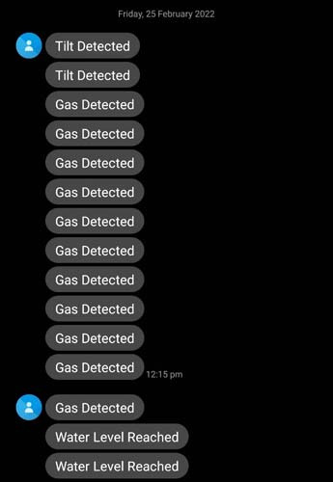
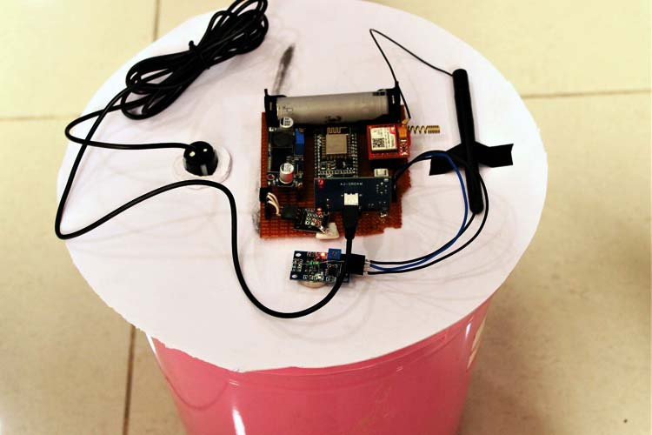
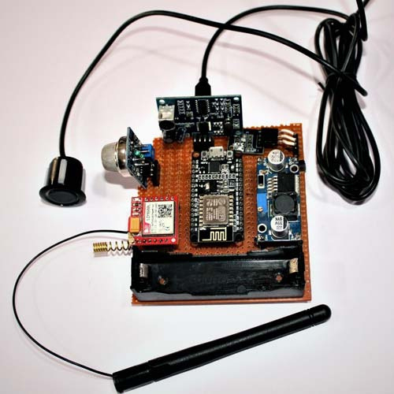
EXPECTED OUTCOMES

Slide 11
Manhole Monitoring System Code
The code starts by including the SoftwareSerial library and defining the NodeMCU pins connected to the sensor and GSM module.
#include <SoftwareSerial.h>
#define sensor D5
#define ECHOPIN D7
#define TRIGPIN D6
int sensorPin = A0;
SoftwareSerial mySerial(D3, D2);
The code starts by including the SoftwareSerial library and defining the NodeMCU pins connected to the sensor and GSM module.
#include <SoftwareSerial.h>
#define sensor D5
#define ECHOPIN D7
#define TRIGPIN D6
int sensorPin = A0;
SoftwareSerial mySerial(D3, D2);

Slide 12
In the loop, first, we are reading the Tilt sensor and Gas sensor readings using digitalRead() and analogRead() functions and then to measure the distance using ultrasonic sensor,
int readings = digitalRead(sensor);
int val = analogRead(A0);
digitalWrite(TRIGPIN, LOW);
delayMicroseconds(2);
digitalWrite(TRIGPIN, HIGH);
delayMicroseconds(15);
digitalWrite(TRIGPIN, LOW);
int distance1 = pulseIn(ECHOPIN, HIGH, 26000);
int distance=distance1/58;
Serial.println(distance);
Serial.println(" cm");
delay(500);

Slide 13
Then in last, we are comparing these readings and if the readings exceed a predefined value, then we will use the GSM module to send the SMS notifications. The AT commands to send messages are explained below:
AT+CMGF=1 – Used to select message format as text. By default, the format is Protocol Data Unit (PDU)
AT+CMGS=+ZZxxxxxxxxxx – This command with the phone number specified sends an SMS message to a GSM phone.
mySerial.println("AT"); //Once the handshake test is successful, it will back to OK
updateSerial();
mySerial.println("AT+CMGF=1"); // Configuring TEXT mode
updateSerial();
mySerial.println("AT+CMGS=\"+919829559608\"");
updateSerial();
mySerial.print("Tilt Detected"); //text content
updateSerial();
mySerial.write(26);

Slide 14
#include <SoftwareSerial.h>
#define sensor D5
#define ECHOPIN D7
#define TRIGPIN D6
int sensorPin = A0;
//Create software serial object to communicate with SIM800L
SoftwareSerial mySerial(D3, D2); //SIM800L Tx & Rx is connected to Arduino #3 & #2
void setup()
{
//Begin serial communication with Arduino and Arduino IDE (Serial Monitor)
Serial.begin(9600);
pinMode(sensor, INPUT);
pinMode(ECHOPIN,INPUT_PULLUP);
pinMode(TRIGPIN, OUTPUT);
digitalWrite(ECHOPIN, HIGH);
//Begin serial communication with Arduino and SIM800L
mySerial.begin(9600);
delay(1000);
}
CODE

Slide 15
void loop()
{
int readings = digitalRead(sensor);
int val = analogRead(A0);
//Serial.println(IR_readings);
digitalWrite(TRIGPIN, LOW);
delayMicroseconds(2);
digitalWrite(TRIGPIN, HIGH);
delayMicroseconds(15);
digitalWrite(TRIGPIN, LOW);
int distance1 = pulseIn(ECHOPIN, HIGH, 26000);
int distance=distance1/58;
Serial.println(distance);
Serial.println(" cm");
delay(500);
if (readings == 1 )
{
//Serial.print("Tilt Detected");
mySerial.println("AT"); //Once the handshake test is successful, it will back to OK
updateSerial();
mySerial.println("AT+CMGF=1"); // Configuring TEXT mode
updateSerial();
mySerial.println("AT+CMGS=\"+zzxxxxxxxxxxx\"");//change ZZ with country code and xxxxxxxxxxx with phone number to sms
updateSerial();
mySerial.print("Tilt Detected"); //text content
updateSerial();
mySerial.write(26);
}

Slide 16
if (distance <= 20)
{
Serial.print("Water Level");
mySerial.println("AT"); //Once the handshake test is successful, it will back to OK
updateSerial();
mySerial.println("AT+CMGF=1"); // Configuring TEXT mode
updateSerial();
mySerial.println("AT+CMGS=\"+919829559608\"");//change ZZ with country code and xxxxxxxxxxx with phone number to sms
updateSerial();
mySerial.print("Water Level Reached"); //text content
updateSerial();
mySerial.write(26);
}
if (val > 80 )
{
Serial.print("Gas Detected");
mySerial.println("AT"); //Once the handshake test is successful, it will back to OK
updateSerial();
mySerial.println("AT+CMGF=1"); // Configuring TEXT mode
updateSerial();
mySerial.println("AT+CMGS=\"+919829559608\"");//change ZZ with country code and xxxxxxxxxxx with phone number to sms
updateSerial();
mySerial.print("Gas Detected"); //text content
updateSerial();
mySerial.write(26);
}
delay(1000);
}
void updateSerial()
{
delay(500);
while (Serial.available())
{
mySerial.write(Serial.read());//Forward what Serial received to Software Serial Port
}
while(mySerial.available())
{
Serial.write(mySerial.read());//Forward what Software Serial received to Serial Port
}
}

Slide 17
THANK YOU

